Slide 1
Advantages and Disadvantages of Wargaming
Yuna Huh Wong, PhD
September 13, 2023

Slide 2
Agenda
Personal Background
Definitions of Wargaming
Things That Don’t Count as Wargames
Advantages
Disadvantages
How to Lie with Wargames
What’s Changed with the War in Ukraine?
Artificial Intelligence and Wargaming: Worshipping False Idols

Slide 3
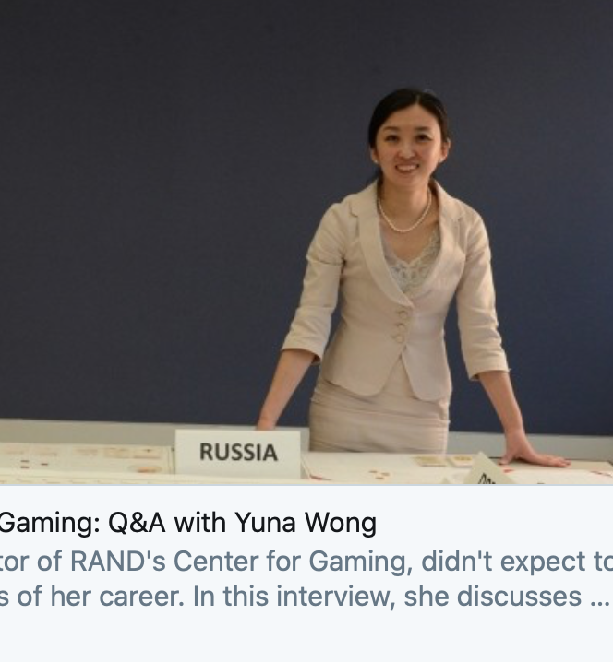
Personal Introduction

Slide 4
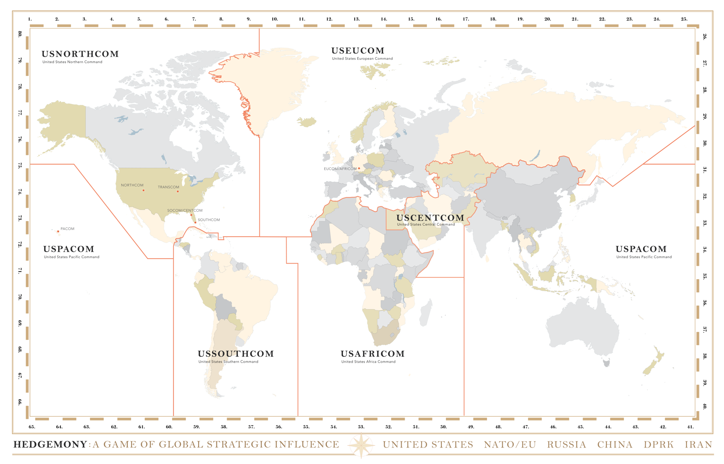
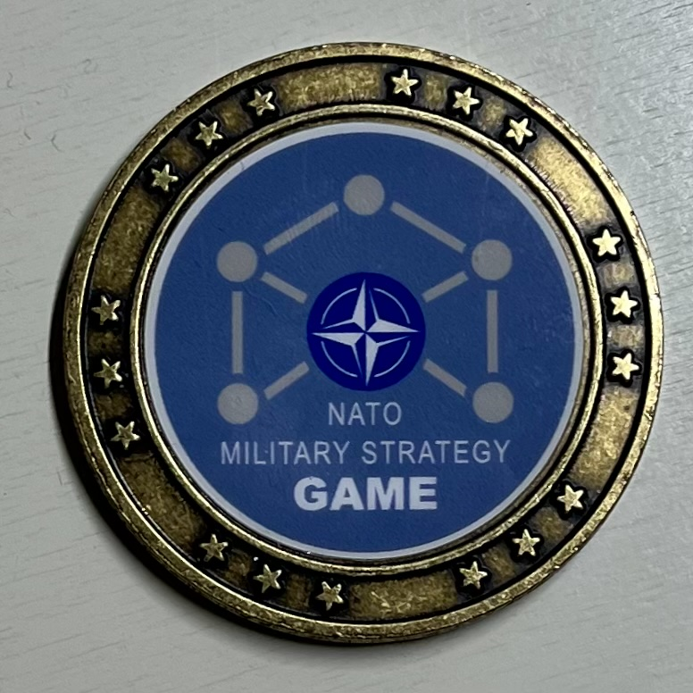
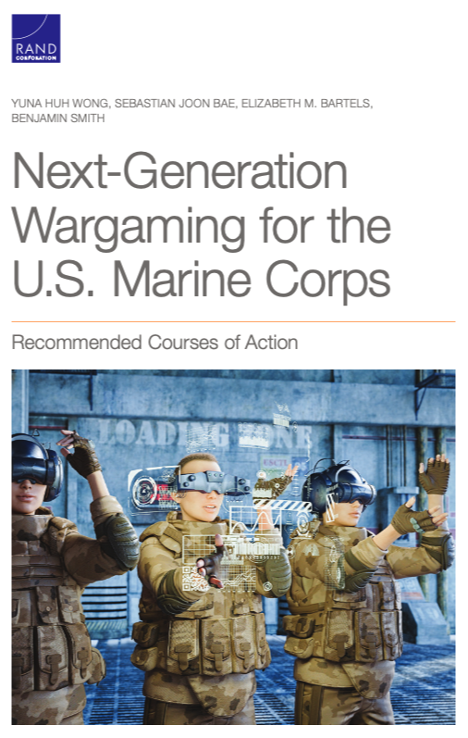
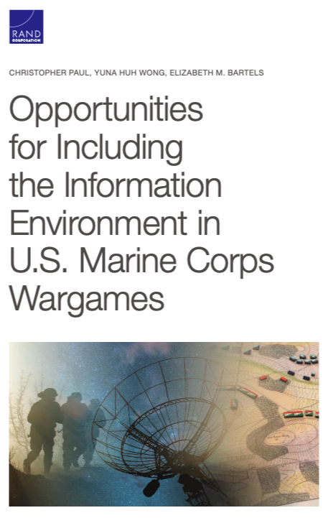
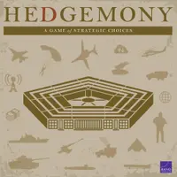
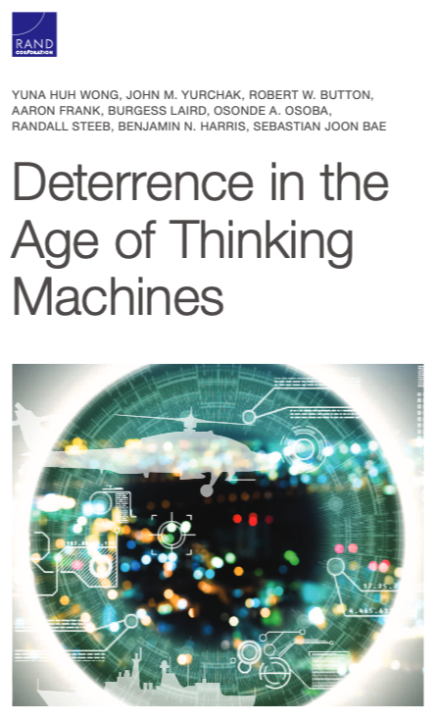
Some of My Work in Wargaming

Slide 5
Definitions of Wargaming
Peter Perla’s The Art of Wargaming, 2022
Joint Publication 5-0, Joint Planning, 2020
“A warfare model or simulation, not involving actual military forces, and in which the flow of events is affected by and in turn affects decisions made during the course of those events by players representing the opposing sides.” (p. 392)
“Wargames are representations of conflict or competition in a synthetic environment, in which people make decisions and respond to the consequences of those decisions.” (p. III-45)

Slide 6
Advantages
“Story Living”
Insights
Well-designed wargames are highly engaging and memorable
Role playing helps drive home red & green perspectives
Play is a highly effective form of learning for children
Should be a source of “aha” moments
Thomas Schelling: no one, no matter how intelligent, can make a list of the things that would not occur to them

Slide 7
Advantages
Organizational Advantages
Low-Cost Opportunity to Fail
Can be effective at challenging assumptions
Can improve communication and coordination between organizations who will have to operate together in a crisis
Can be a teaching tool
Better to fail in the wargame than in real life
Repeated gaming with the same players may improve organizational learning

Slide 8
Disadvantages
Wargaming Doesn’t Easily Scale
Professional Wargaming Community is Small
Time and resource intensive
Bigger games aren’t necessarily better
Impossible to effectively integrate everything people want in a wargame
Shortage of skilled wargamers is problematic
Informal community of practice
Very few professional games are ever published for other wargamers to examine

Slide 9
Disadvantages
Wargaming Doesn’t Free You From Biases
Better for Exploration Than Prediction or Analysis
Potential for groupthink in scenarios and assumptions about the adversary
Potential for negative learning
Expert adjudication will reflect the last war
Very difficult to wargame the future with today’s humans
Adjudicated wargames don’t “validate” or prove anything
Wargames are not validated instruments for measuring anything

Slide 10
Disadvantages
Wargames Are an Extension of Politics
Lack of Empirical Proof for Wargaming’s Effectiveness
People bring their organizational equities into the wargame
People bring their previous positions into a wargame
Adjudication rules are also a mental model and are not free of human biases
There is no empirical proof that wargames outperform other approaches
We don’t actually know wargaming’s effectiveness in individual creative or critical thinking, small group learning, or organizational innovation

Slide 11
How to Lie With Wargames
Social Engineering
Stacking the Deck
Have your list of foregone conclusions that you want captured in the final report
Bias results by leaning into deference for authority to privilege certain positions
Introduce anchoring bias at the beginning of the game
Limit range of red actions
Run the wargame exactly twice with base tech & new tech:
Attribute all learning between games to the effectiveness of new tech
Prevent the red cell from any more opportunities to figure out ways to counter new tech

Slide 12
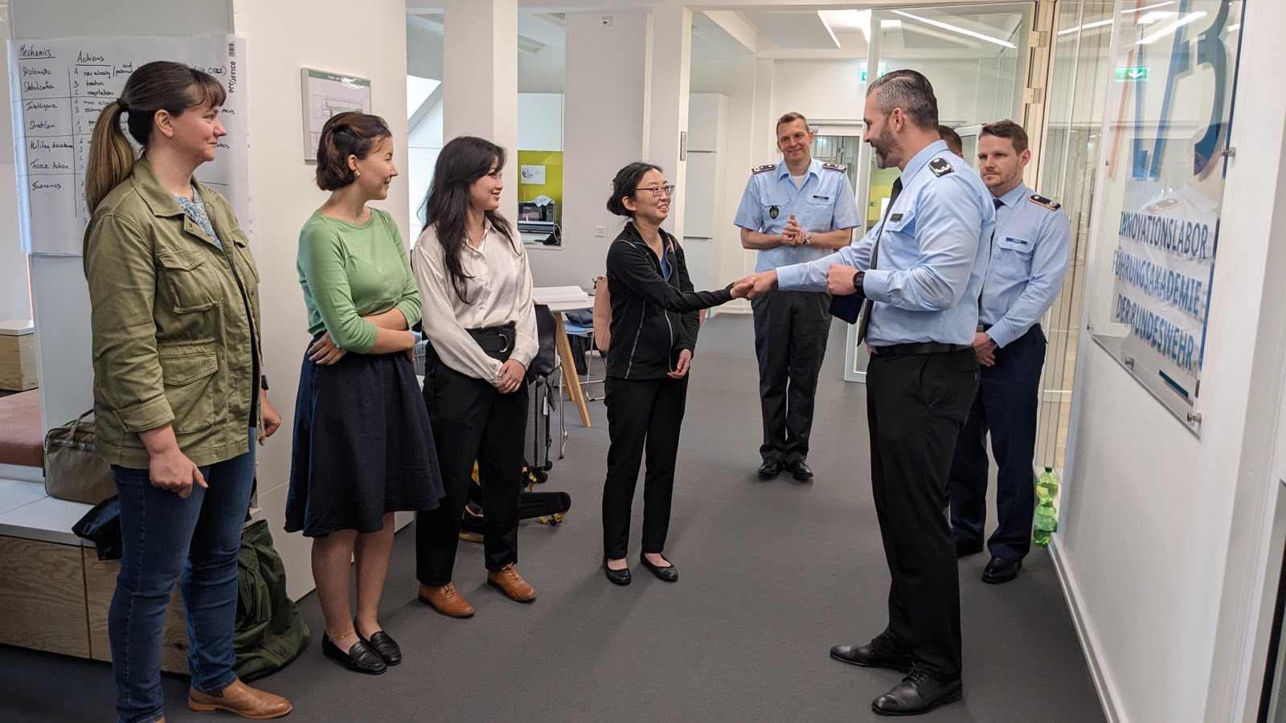
What’s Changed With the War in Ukraine?
z
For U.S. wargaming: nothing has changed
U.S. wargaming has continued revival since 2015
European interest in wargaming lagged
War has supercharged interested in wargaming within NATO
Interest in Asia?

Slide 13
Artificial Intelligence and Wargaming: Worshipping False Gods
Reasonable AI Applications
Unreasonable AI Applications
Using chatbots for scenario development
Exploring issues for historical hobby wargames
Generative images and video for visual supplements
Short term: drafting sections wargame reports
Adjudication (ML)
Developing course of action development
Playing the adversary in a professional wargame
Anything yet on classified systems

